Slide 1
Machine Learning
Dr. Shazzad Hosain
Department of EECS
North South Universtiy
shazzad@northsouth.edu

Slide 2
What is Machine Learning?
Learning
algorithm
Trained
machine
TRAINING
DATA
Answer
?
Data Mining is similar concept
Query
Notes:
What is the process in data mining ?

Slide 3
For which tasks ?
Classification (binary/categorical target)
Regression and time series prediction (continuous targets)
Clustering (targets unknown)
Rule discovery
Notes:
What are the magical things which DM can achieve
Pb with clustering : « when we do not know the target »
This goes against our concept of « segmentation » where we use supervised k-means, which we advocate actually ! We use the supervised info for coding the data

Slide 4
For which applications ?
training examples
Customer knowledge
Quality control
10⁶
Market Analysis
OCR
HWR
10⁵
Machine vision
Text Categorization
10⁴
10³
System diagnosis
Bioinformatics
10²
10
10
10²
10³
10⁴
10⁵
inputs
Notes:
Depending upon the appli. we have more examples / more inputs

Slide 5
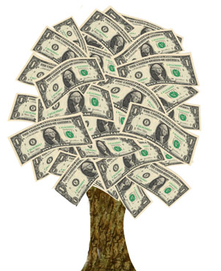
Banking / Telecom / Retail
Identify:
  Prospective customers
  Dissatisfied customers
  Good customers
  Bad payers
Obtain:
  More effective advertising
  Less credit risk
  Fewer fraud
  Decreased churn rate
Notes:
Your churn rate is the amount of customers or subscribers who cut ties with your service or company during a given time period.

Slide 6


Biomedical / Biometrics
Medicine:
  Screening
  Diagnosis and prognosis
  Drug discovery
Security:
  Face recognition
  Signature / fingerprint / iris verification
  DNA fingerprinting

Slide 7

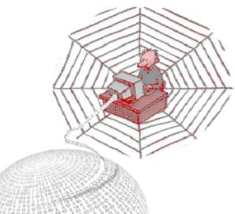
Computer / Internet
Computer interfaces:
  Troubleshooting wizards
  Handwriting and speech
  Brain waves
Internet
  Hit ranking
  Spam filtering
  Text categorization
  Text translation
  Recommendation
Notes:
Include here recommandation systems

Slide 8
ML in a Nutshell
Tens of thousands of machine learning algorithms
Hundreds new every year
Every machine learning algorithm has three components:
  Representation
  Evaluation
  Optimization
Machine Learning

Slide 9
Representation
Decision trees
Sets of rules / Logic programs
Instances
Graphical models (Bayes/Markov nets)
Neural networks
Support vector machines
Model ensembles
Etc.
Machine Learning

Slide 10
Evaluation
Accuracy
Precision and recall
Squared error
Likelihood
Posterior probability
Cost / Utility
Margin
Entropy
K-L divergence
Etc.
Machine Learning

Slide 11
Optimization
Combinatorial optimization
  E.g.: Greedy search
Convex optimization
  E.g.: Gradient descent
Constrained optimization
  E.g.: Linear programming
Machine Learning

Slide 12
Types of Learning
Supervised (inductive) learning
  Training data includes desired outputs
Unsupervised learning
  Training data does not include desired outputs
Semi-supervised learning
  Training data includes a few desired outputs
Reinforcement learning
  Rewards from sequence of actions
Machine Learning

Slide 13
Supervised Learning
Learning Through Examples

Slide 14
Supervised Learning
When a set of targets of interest is provided by an external teacher
we say that the learning is Supervised
The targets usually are in the form of an input output mapping that the net should learn

Slide 15
Learning From Examples
1 9
16 36
25 4
1 3
4 6
5 2

Slide 16
What We’ll Cover
Supervised learning
  Decision tree induction
  Neural networks
  Rule induction
  Instance-based learning
  Bayesian learning
  Support vector machines
  Model ensembles
  Learning theory
Machine Learning

Slide 17
Classification: Decision Trees
if X > 5 then blue
else if Y > 3 then blue
else if X > 2 then green
else blue
Y
3
2
5
X

Slide 18
Classification: Neural Nets
Can select more complex regions
Can be more accurate
Also can overfit the data – find patterns in random noise

Slide 19
Decision Tree Learning
Learning Through Examples

Slide 20
Learning decision trees
Problem: decide whether to wait for a table at a restaurant, based on the following attributes:
  Alternate: is there an alternative restaurant nearby?
  Bar: is there a comfortable bar area to wait in?
  Fri/Sat: is today Friday or Saturday?
  Hungry: are we hungry?
  Patrons: number of people in the restaurant (None, Some, Full)
  Price: price range ($, $$, $$$)
  Raining: is it raining outside?
  Reservation: have we made a reservation?
  Type: kind of restaurant (French, Italian, Thai, Burger)
  WaitEstimate: estimated waiting time (0-10, 10-30, 30-60, >60)

Slide 21
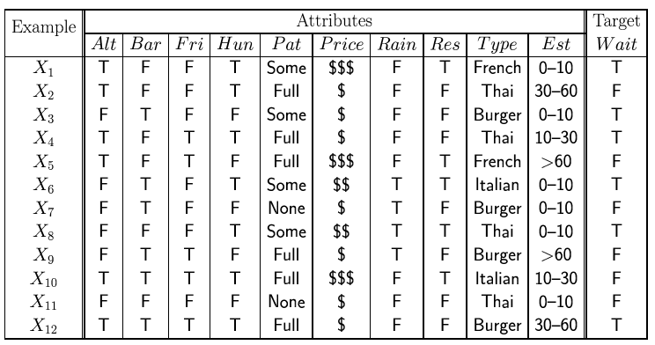
Attribute-based representations
Examples described by attribute values (Boolean, discrete, continuous)
E.g., situations where I will/won't wait for a table:
Classification of examples is positive (T) or negative (F)

Slide 22
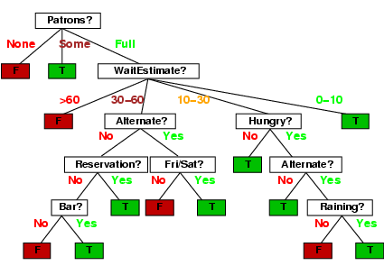
Decision tree

Slide 23
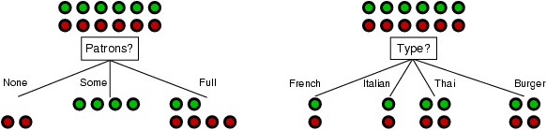
Choosing an attribute
Idea: a good attribute splits the examples into subsets that are (ideally) "all positive" or "all negative“
Patrons? is a better choice

Slide 24
Choosing the Best Attribute
The key problem is choosing which attribute to split a given set of examples.
Some possibilities are:
  Random: Select any attribute at random
  Least-Values: Choose the attribute with the smallest number of possible values (fewer branches)
  Most-Values: Choose the attribute with the largest number of possible values (smaller subsets)
  Max-Gain: Choose the attribute that has the largest expected information gain, i.e. select attribute that will result in the smallest expected size of the subtrees rooted at its children.
The ID3 algorithm uses the Max-Gain method of selecting the best attribute.

Slide 25
ID3 (Iterative Dichotomiser 3) Algorithm
  Top-down, greedy search through space of possible decision trees
    Remember, decision trees represent hypotheses, so this is a search through hypothesis space.
  What is top-down?
    How to start tree?
      What attribute should represent the root?
    As you proceed down tree, choose attribute for each successive node.
    No backtracking:
      So, algorithm proceeds from top to bottom
Notes:
A dichotomy is any splitting of a whole into exactly two non-overlapping parts, meaning it is a procedure in which a whole is divided into two parts. It is a partition of a whole (or a set) into two parts (subsets) that are:

Slide 26
Question?
How do you determine which attribute best classifies data?
Answer: Entropy!
Entropy is a measure of disorder or impurity
Information gain:
  Measures the expected reduction in entropy caused by partitioning
  Statistical quantity measuring how well an attribute classifies the data.
    Calculate the information gain for each attribute.
    Choose attribute with greatest information gain.

Slide 27
Information Theory Background
If there are n equally probable possible messages, then the probability p of each is 1/n
Information conveyed by a message is -log(p) = log(n)
Eg, if there are 16 messages, then log(16) = 4 and we need 4 bits to identify/send each message.
In general, if we are given a probability distribution
  P = (p₁, p₂, .., p_{n})
the information conveyed by distribution (aka Entropy of P) is:
  H(P) = -(p₁*log(p₁) + p₂*log(p₂) + .. + p_{n}*log(p_{n}))
Notes:
Aka i.e. also known as
In information theory, entropy is the average amount of information contained in each message received. Here, message stands for an event, sample or character drawn from a distribution or data stream. Entropy thus characterizes our uncertainty about our source of information. (Entropy is best understood as a measure of uncertainty rather than certainty as entropy is larger for more random sources.)

Slide 28
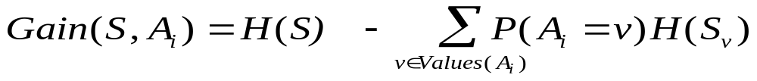
  Information Gain
  Information gain is our metric for how well one attribute A _{i} classifies the training data.
  Calculate the entropy for all training examples
    positive and negative cases
    p₊ = #pos/Tot p₋ = #neg/Tot
    H(S) = -p₊log₂(p₊) - p₋log₂(p₋)
  Determine which single attribute best classifies the training examples using information gain.
    For each attribute find:
    Use attribute with greatest information gain as a root
    Gain (S, A) = expected reduction in entropy due to sorting on A
entropy
Entropy for value v

Slide 29
Example: PlayTennis
  Four attributes used for classification:
    Outlook = {Sunny, Overcast, Rain}
    Temperature = {Hot, Mild, Cool}
    Humidity = {High, Normal}
    Wind = {Weak, Strong}
  One predicted (target) attribute (binary)
    PlayTennis = {Yes, No}
  Given 14 Training examples
    9 positive
    5 negative

Slide 30
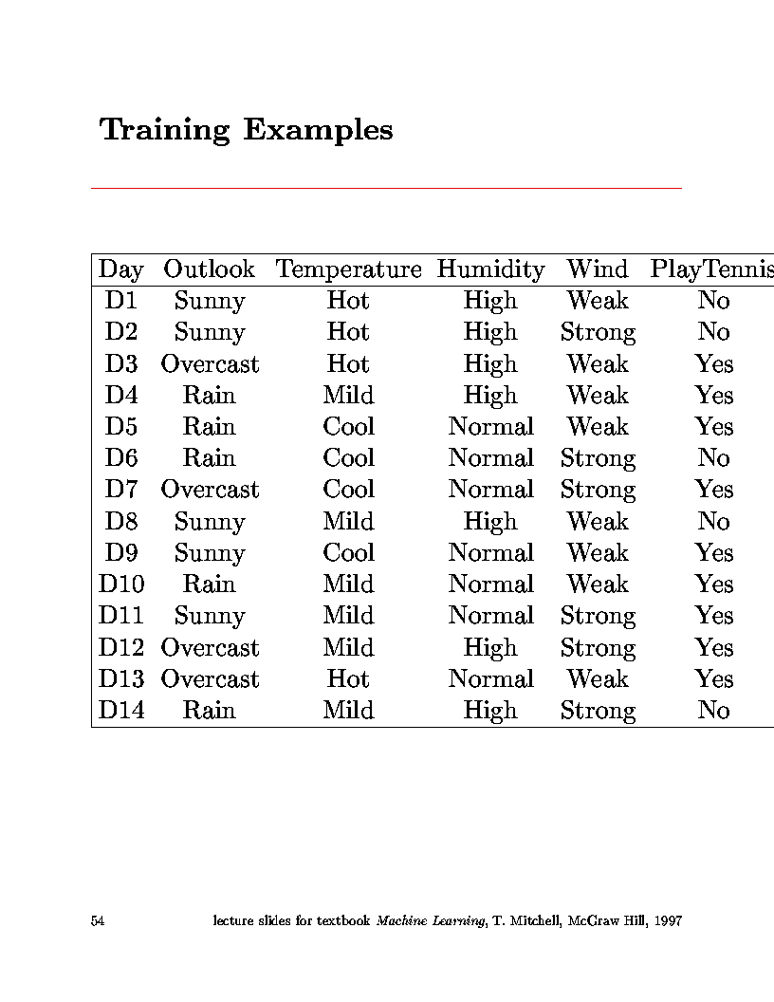
Examples, minterms, cases, objects, test cases,
Training Examples

Slide 31
14 cases
9 positive cases
Step 1: Calculate entropy for all cases:
      N_{Pos} = 9 N_{Neg} = 5 N_{Tot} = 14
      H(S) = -(9/14)*log₂(9/14) - (5/14)*log₂(5/14) = 0.940
entropy

Slide 32
Step 2: Loop over all attributes, calculate gain:
  Attribute = Outlook
    Loop over values of Outlook
      Outlook = Sunny
      N_{Pos} = 2 N_{Neg} = 3 N_{Tot} = 5
      H(Sunny) = -(2/5)*log₂(2/5) - (3/5)*log₂(3/5) = 0.971
      Outlook = Overcast
      N_{Pos} = 4 N_{Neg} = 0 N_{Tot} = 4
      H(Overcast) = -(4/4)*log₂4/4) - (0/4)*log₂(0/4) = 0.00

Slide 33
      Outlook = Rain
      N_{Pos} = 3 N_{Neg} = 2 N_{Tot} = 5
      H(Rain) = -(3/5)*log₂(3/5) - (2/5)*log₂(2/5) = 0.971
    Calculate Information Gain for attribute Outlook
    Gain(S, Outlook) = H(S) - N_{Sunny}/N_{Tot}*H(Sunny)
    - N_{Over}/N_{Tot}*H(Overcast)
    - N_{Rain}/N_{Tot}*H(Rain)
    Gain(S, Outlook) = 0.940 - (5/14)*0.971 - (4/14)*0 - (5/14)*0.971
    Gain(S, Outlook) = 0.246
Notes:
Entropy high means high uncertainty, less means more certainty
The attribute that has less entropy has maximum information gain. That attribute brings more certainty in classification.

Slide 34
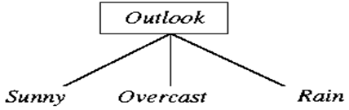
  Attribute = Temperature
    (Repeat process looping over {Hot, Mild, Cool})
    Gain(S, Temperature) = 0.029
  Attribute = Humidity
    (Repeat process looping over {High, Normal})
    Gain(S, Humidity) = 0.029
  Attribute = Wind
    (Repeat process looping over {Weak, Strong})
    Gain(S, Wind) = 0.048
  Find attribute with greatest information gain:
  Gain(S,Outlook) = 0.246, Gain(S,Temperature) = 0.029
  Gain(S,Humidity) = 0.029, Gain(S,Wind) = 0.048
  ∴ Outlook is root node of tree

Slide 35
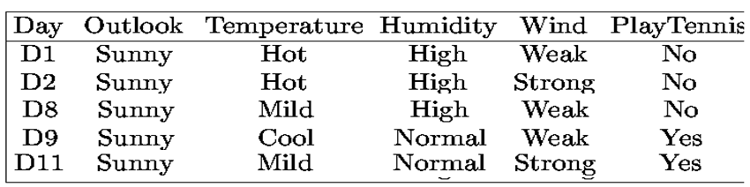
  Iterate algorithm to find attributes which best classify training examples under the values of the root node
  Example continued
    Take three subsets:
      Outlook = Sunny (N_{Tot} = 5)
      Outlook = Overcast (N_{Tot} = 4)
      Outlook = Rainy (N_{Tot} = 5)
    For each subset, repeat the above calculation looping over all attributes other than Outlook

Slide 36
  For example:
    Outlook = Sunny (N_{Pos} = 2, N_{Neg}=3, N_{Tot} = 5) H=0.971
      Temp = Hot (N_{Pos} = 0, N_{Neg}=2, N_{Tot} = 2) H = 0.0
      Temp = Mild (N_{Pos} = 1, N_{Neg}=1, N_{Tot} = 2) H = 1.0
      Temp = Cool (N_{Pos} = 1, N_{Neg}=0, N_{Tot} = 1) H = 0.0
      Gain(S_{Sunny}, Temperature) = 0.971 - (2/5)*0 - (2/5)*1 - (1/5)*0
      Gain(S_{Sunny}, Temperature) = 0.571
    Similarly:
    Gain(S_{Sunny}, Humidity) = 0.971
    Gain(S_{Sunny}, Wind) = 0.020
    Humidity classifies Outlook=Sunny
    instances best and is placed as the node under
    Sunny outcome.
  Repeat this process for Outlook = Overcast & Rainy

Slide 37
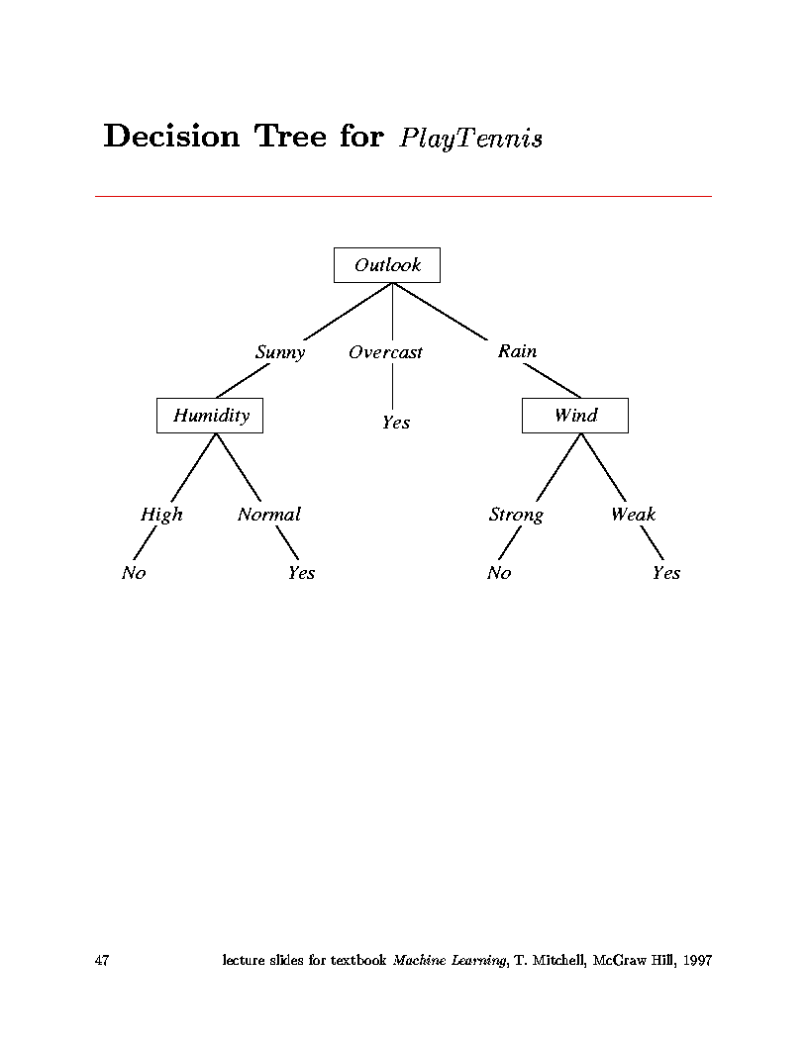
  End up with tree:

Slide 38
  Important:
    Attributes are excluded from consideration if they appear higher in the tree
  Process continues for each new leaf node until:
    Every attribute has already been included along path through the tree
    or
    Training examples associated with this leaf all have same target attribute value.

Slide 39
  Note: In this example data were perfect.
    No contradictions
    Branches led to unambiguous Yes, No decisions
    If there are contradictions take the majority vote
      This handles noisy data.
  Another note:
    Attributes are eliminated when they are assigned to a node and never reconsidered.
      e.g. You would not go back and reconsider Outlook under Humidity
  ID3 uses all of the training data at once
    Contrast to Candidate-Elimination
    Can handle noisy data.

Slide 40
The ID3 algorithm is used to build a decision tree, given a set of non-categorical attributes C1, C2, .., Cn, the categorical attribute C, and a training set T of records.
function ID3 (R: a set of non-categorical attributes,
C: the categorical attribute,
S: a training set) returns a decision tree;
begin
If S is empty, return a single node with value Failure;
If every example in S has the same value for categorical
attribute, return single node with that value;
If R is empty, then return a single node with most
frequent of the values of the categorical attribute found in
examples S; [note: there will be errors, i.e., improperly
classified records];
Let D be attribute with largest Gain(D,S) among R’s attributes;
Let {dj| j=1,2, .., m} be the values of attribute D;
Let {Sj| j=1,2, .., m} be the subsets of S consisting
respectively of records with value dj for attribute D;
Return a tree with root labeled D and arcs labeled
d1, d2, .., dm going respectively to the trees
ID3(R-{D},C,S1), ID3(R-{D},C,S2) ,.., ID3(R-{D},C,Sm);
end ID3;

Slide 41
About Entropy and Information Gain
Decision Tree Learning

Slide 42
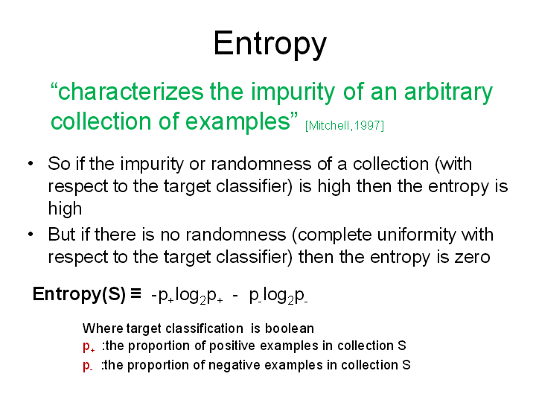

Slide 43
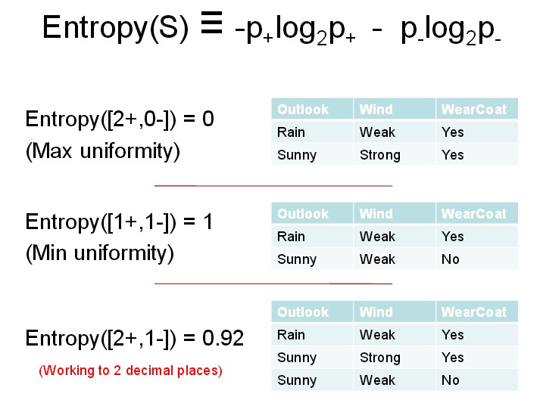

Slide 44
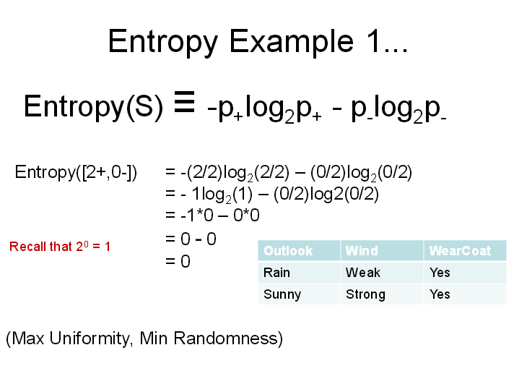

Slide 45
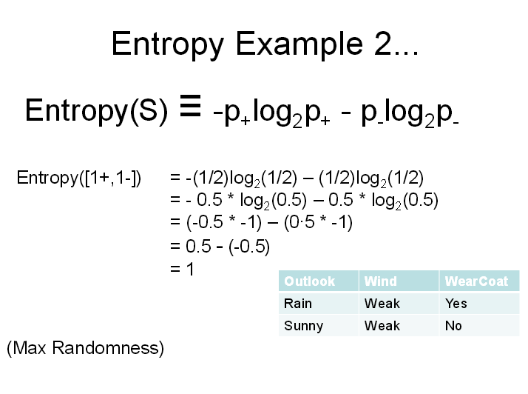

Slide 46
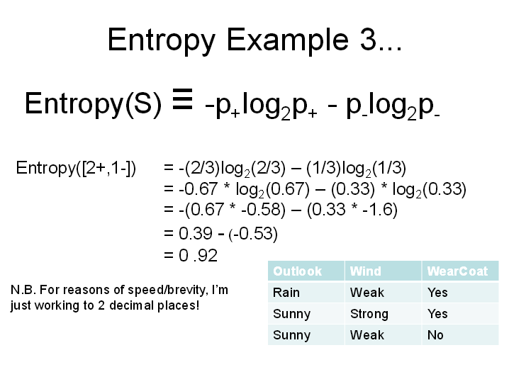

Slide 47
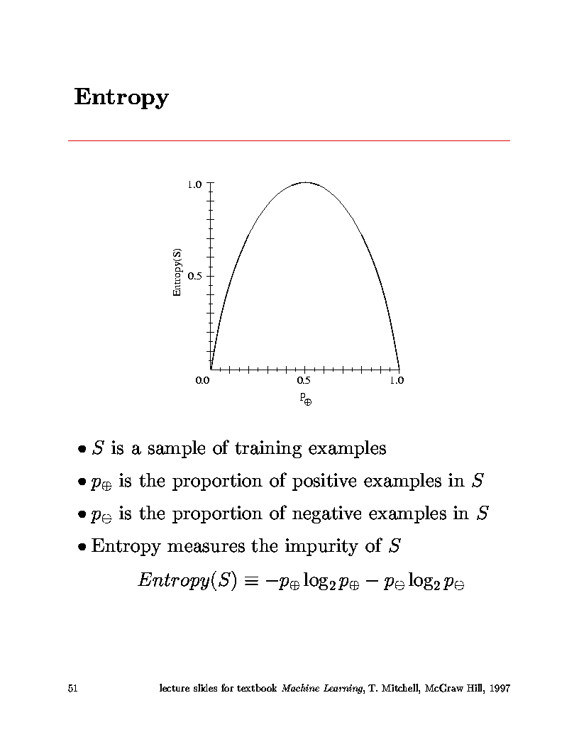
Largest entropy
Entropy
Boolean functions with the same number of ones and zeros have largest entropy

Slide 48
  Does Entropy Make Sense?
  If an event conveys information, that means it’s a surprise.
  If an event always occurs, P(A_{i})=1, then it carries no information. -log₂(1) = 0
  If an event rarely occurs (e.g. P(A_{i})=0.001), it carries a lot of info. -log₂(0.001) = 9.97
  The less likely (uncertain) the event, the more the information it carries since, for 0 ≤ P(A_{i}) ≤ 1,
  -log₂(P(A_{i})) increases as P(A_{i}) goes from 1 to 0.
    (Note: ignore events with P(A_{i})=0 since they never occur.)

Slide 49
Information Gain
Measures the expected reduction in entropy caused by partitioning
Statistical quantity measuring how well an attribute classifies the data.
Maximum gain means minimum entropy for attribute Ai, meaning Ai has less randomness in classifying
entropy
Entropy for value v

Slide 50
Hypothesis Space
Decision Tree Learning

Slide 51
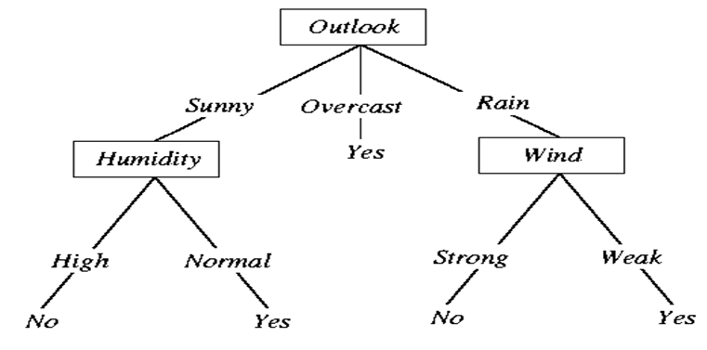
Hypothesis Space
The tree itself forms hypothesis
  Disjunction (OR’s) of conjunctions (AND’s)
  Each path from root to leaf forms conjunction of constraints on attributes
  Separate branches are disjunctions
Example from PlayTennis decision tree:
  (Outlook=Sunny ∧ Humidity=Normal)
  ∨
  (Outlook=Overcast)
  ∨ 
  (Outlook=Rain ∧ Wind=Weak)

Slide 52
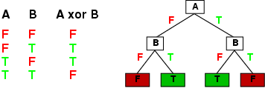
Expressiveness
Decision trees can express any function of the input attributes.
E.g., for Boolean functions, truth table row → path to leaf:
Trivially, there is a consistent decision tree for any training set with one path to leaf for each example (unless f nondeterministic in x) but it probably won't generalize to new examples
Prefer to find more compact decision trees

Slide 53
Hypothesis spaces
How many distinct decision trees with n Boolean attributes?
= number of Boolean functions
= number of distinct truth tables with 2^{n} rows = 2^{2n}
E.g., with 6 Boolean attributes, there are 18,446,744,073,709,551,616 trees
Aim: find a small tree consistent with the training examples
Idea: (recursively) choose "most significant" attribute as root of (sub)tree
Notes:
For two attributes, four rows. Each row can have two outcomes, true or false. So there are 2x2x2x2 different distinct truth tables.

Slide 54
Extensions of Decision Tree Learning

Slide 55
Extensions of the Decision Tree Learning
Noisy data and Overfitting
Cross-Validation for Experimental Validation of Performance
Pruning Decision Trees
Real-valued data
Using gain ratios
Generation of rules
Setting Parameters
Incremental learning

Slide 56
Noisy data and Overfitting
Many kinds of "noise" that could occur in the examples:
  Two examples have same attribute/value pairs, but different classifications
  Some values of attributes are incorrect because of:
    Errors in the data acquisition process
    Errors in the preprocessing phase
  The classification is wrong (e.g., + instead of -) because of some error
Some attributes are irrelevant to the decision-making process,
  e.g., color of a die is irrelevant to its outcome.
  Irrelevant attributes can result in overfitting the training data.

Slide 57
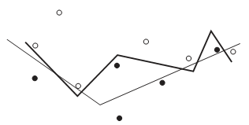
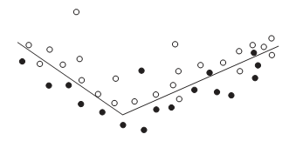
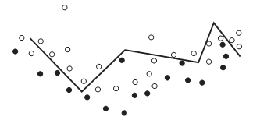
Noisy data and Overfitting
Black dots are positive, others negative
Two lines represent two hypothesis
Thick line is complex hypothesis correctly classifies all data
Thin line is simple hypothesis but incorrectly classifies some data
The simple hypothesis makes some errors but reasonably closely represents the trend in the data
The complex solution does not at all represent the full set of data
Fix overfitting /overlearning problem
  By cross validation
  By pruning lower nodes in the decision tree.

Slide 58
Cross Validation: An Evaluation Methodology
Standard methodology: cross validation
  1. Collect a large set of examples (all with correct classifications!).
  2. Randomly divide collection into two disjoint sets: training and test.
  3. Apply learning algorithm to training set giving hypothesis H
  4. Measure performance of H w.r.t. test set
Important: keep the training and test sets disjoint!
Learning is not to minimize training error (wrt data) but the error for test/cross-validation: a way to fix overfitting
To study the efficiency and robustness of an algorithm, repeat steps 2-4 for different training sets and sizes of training sets.
If you improve your algorithm, start again with step 1 to avoid evolving the algorithm to work well on just this collection.

Slide 59
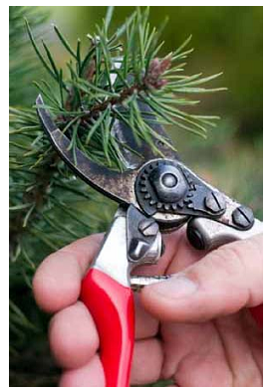
Pruning Decision Trees
Pre Pruning: Stop growing before a fully grown tree
Post Pruning : Trim fully grown tree from the bottom
  Reduced Error Pruning
  Rule post pruning

Slide 60
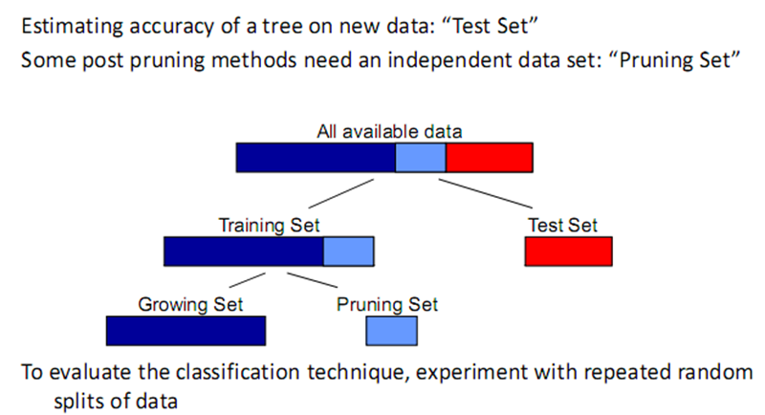
Reduced Error Pruning
Partitioning data in tree induction

Slide 61
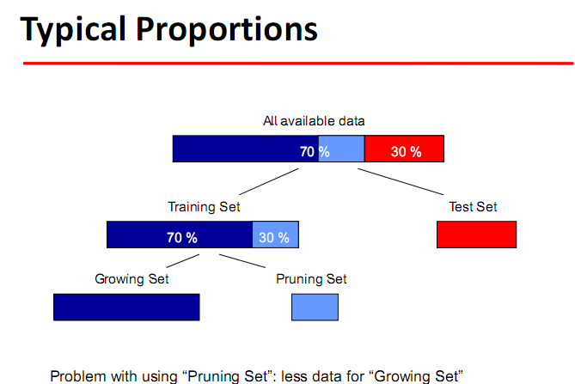

Slide 62
Reduced Error Pruning
A post-pruning, cross-validation approach.
Partition training data in “grow” and “validation” sets.
Build a complete tree from the “grow” data.
Until accuracy on validation set decreases do:
For each non-leaf node, n, in the tree do:
Temporarily prune the subtree below n and replace it with a
leaf labeled with the current majority class at that node.
Measure and record the accuracy of the pruned tree on the validation set.
Permanently prune the node that results in the greatest increase in accuracy on
the validation set.

Slide 63
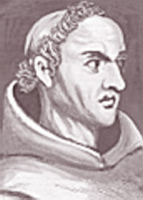
Ockham’s Razor
Principle proposed by William of Ockham in the fourteenth century: “Pluralitas non est ponenda sine neccesitate”.
Of two theories providing similarly good predictions, prefer the simplest one.
Shave off unnecessary parameters of your models.

Slide 64
Real-valued data
Select a set of thresholds defining intervals;
  each interval becomes a discrete value of the attribute
We can use some simple heuristics
  always divide into quartiles
We can use domain knowledge
  divide age into infant (0-2), toddler (3 - 5), and school aged (5-8)
or treat this as another learning problem
  try a range of ways to discretize the continuous variable
  Find out which yield “better results” with respect to some metric.

Slide 65
Performance Evaluation
Decision Tree Learning

Slide 66
Metrics for Performance Evaluation
Focus on the predictive capability of a model
  Rather than how fast it takes to classify or build models, scalability, etc.
Confusion Matrix:
TP: predicted to be in YES, and is actually in it
FP: predicted to be in YES, but is not actually in it
TN: predicted not to be in YES, and is not actually in it
FN: predicted not to be in YES, but is actually in it
 | PREDICTED CLASS
ACTUAL CLASS |  | Class=Yes | Class=No
 | Class=Yes | TP | FN
 | Class=No | FP | TN
TP (true positive)
FN (false negative)
FP (false positive)
TN (true negative)

Slide 67
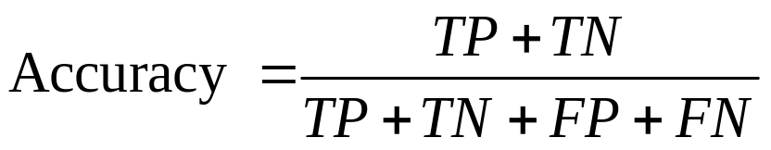
Metrics for Performance Evaluation…
Accuracy
 | PREDICTED CLASS
ACTUAL CLASS |  | Class=Yes | Class=No
 | Class=Yes | TP | FN
 | Class=No | FP | TN
Most widely-used metric:

Slide 68
Limitation of Accuracy
Class imbalance problem
Consider a 2-class problem
  Number of Class 0 examples = 9990
  Number of Class 1 examples = 10
If model predicts everything to be class 0, accuracy is 9990/10000 = 99.9 %
  Accuracy is misleading because model does not detect any class 1 example

Slide 69
Classifier Evaluation Metrics:
Accuracy, Error Rate, Sensitivity and Specificity
A\P | Yes | No
Yes | TP | FN | P
No | FP | TN | N
 | P’ | N’ | All
Sensitivity: True Positive recognition rate
  Sensitivity = TP/P
Specificity: True Negative recognition rate
  Specificity = TN/N
Classifier Accuracy, or recognition rate: percentage of test set tuples that are correctly classified
  Accuracy = (TP + TN)/All
Error rate: 1 – accuracy, or
  Error rate = (FP + FN)/All

Slide 70
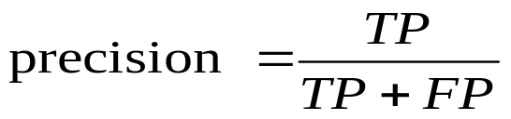
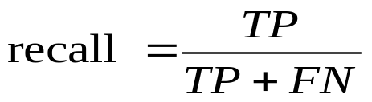
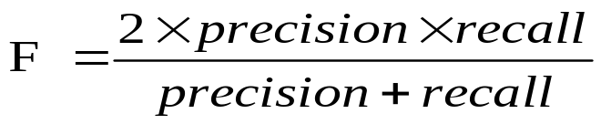
Classifier Evaluation Metrics:
Precision and Recall, and F-measures
Precision: exactness – what % of tuples that the classifier labeled as positive are actually positive
Recall: completeness – what % of positive tuples did the classifier label as positive?
  Perfect score is 1.0
F-measure (F₁ score or F-score)
  harmonic mean of precision and recall,
Precision is biased towards TP & FP
Recall is biased towards TP & FN
F-measure is biased towards all except TN

Slide 71
Classifier Evaluation Metrics:
Matthews correlation coefficient (MCC)
  MCC takes into account true and false positives and negatives.
  Generally regarded as a balanced measure which can be used even if the classes are of very different sizes.
  It returns a value between −1 and +1.
    1 represents a perfect prediction
    0 no better than random prediction
    −1 indicates total disagreement between prediction and observation

Slide 72
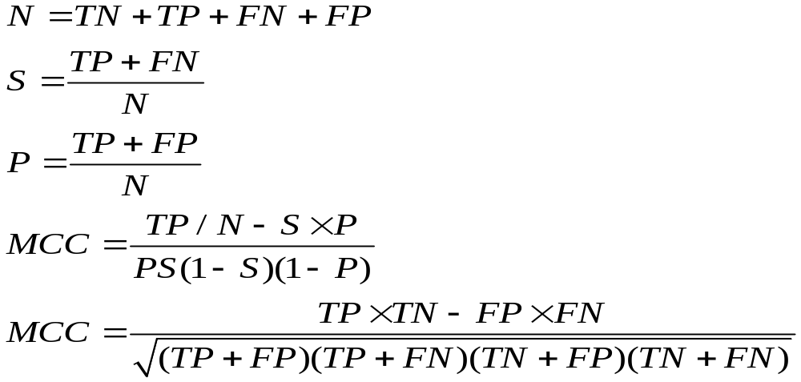
Classifier Evaluation Metrics:
Matthews correlation coefficient (MCC)

Slide 73
Summary
Decision Tree Learning

Slide 74
A greedy search approach
  At each step, make decision which makes greatest improvement in whatever you are trying optimize.
  Do not backtrack (unless you hit a dead end)
  This type of search is likely not to be a globally optimum solution, but generally works well.

Slide 75
Types of problems decision tree learning is good for:
  Instances represented by attribute-value pairs
    For algorithm in book, attributes take on a small number of discrete values
    Robust to imperfect training data
      classification errors
      errors in attribute values
      missing attribute values
    Can be extended to real-valued attributes
      (numerical data)
    Target function has discrete output values
    Algorithm in book assumes Boolean functions
    Can be extended to multiple output values

Slide 76
Example Use
Equipment diagnosis
Medical diagnosis
Credit card risk analysis
Robot movement
Pattern Recognition
  face recognition
  hexapod walking gates

Slide 77
How well does it work?
Many case studies have shown that decision trees are at least as accurate as human experts.
  A study for diagnosing breast cancer:
    humans correctly classifying the examples 65% of the time,
    the decision tree classified 72% correct.
  British Petroleum designed a decision tree for gas-oil separation for offshore oil platforms/
    It replaced an earlier rule-based expert system.
  Cessna designed an airplane flight controller using 90,000 examples and 20 attributes per example.

Slide 78
Summary of DT Learning
Inducing decision trees is one of the most widely used learning methods in practice
Can out-perform human experts in many problems
Strengths include
  Fast
  simple to implement
  can convert result to a set of easily interpretable rules
  empirically valid in many commercial products
  handles noisy data
Weaknesses include:
  "Univariate" splits/partitioning using only one attribute at a time so limits types of possible trees
  large decision trees may be hard to understand
  requires fixed-length feature vectors

Slide 79
References
Chapter 18 of “Artificial Intelligence: A modern approach” by Stuart Russell, Peter Norvig.
Chapter 10 of “AI Illuminated” by Ben Coppin.

